Slide 1




Project Kickoff
August 19, 2015

Slide 2
Agenda
Introductions
Scoping Discussion
Integration Overview
Next Steps

Slide 3
The ShopRunner Team
Team Role | Description | Name(s)
Business Development Executive | Initial contract, business and product terms | Ashish Mittal
Relationship Manager | Accountable for the overall relationship and primary escalation point | Rob Rosone
Integration Manager | Accountable for ensuring quick turnaround to staging needs, questions, spec clarification, code/feed samples | Douglas Dinwoodie
Relationship Executive | Overall escalation point | Richard Bayer
Product / Integration Executive | Escalation for all product and technical issues | Nitin Kulshrestha
Director of Logistics | Liaison for logistics/2-day delivery monitoring | Michael Mashintchian
Developer / QA Resources | Indirect access to Development and QA resources at ShopRunner who can delve into details and also help with QA/UAT | Various

Slide 4
Scope Summary
Description | Comments
Sites in scope | 1800Flowers, 1800Baskets, Fruit Bouquets, Cheryl’s, Fannie May, The Popcorn Factory, Harry & David, and Wolfermans
Product Eligibility | Same Eligibility as Passport
Data Feeds via SFTP or Web service | TBD: 8 separate feeds recommended
Mixed Cart Support | TBD
Returns | Follow existing policy, labels TBD
ShopRunner Express Checkout (SRE) | No
Mobile | Yes
Ship Exclusions (PO Boxes, AK, HI) | TBD
Launch Date Goal | TBD
Placements | Product Detail, Checkout Calendar, Cart, Shipping Address, Review & Pay, Order Summary

Slide 5
Integration Overview
Typical Project steps:
Requirements/Scope
Eligibility
Placement
Member Validation
Web Store
Product Feed
Express Checkout
Order Tracking Pixel
Order Systems
OMS Mapping
Order & Shipping Data Feeds
Certification
Test & Launch
Partner Testing
UAT
Live To Site
Contract Signed Launch

Slide 6
Typical Placements / Flows
Added To Bag
Home
Category
Product Detail
Shopping Cart
ShopRunner
Sign-In
Recipient Shipping Address
Delivery & Gift Message
ShopRunner Message Placements
Review & Place Order
Retailer Flow
Skipped pages
Order Confirmation
ShopRunner Overlay/Lightbox

Slide 7
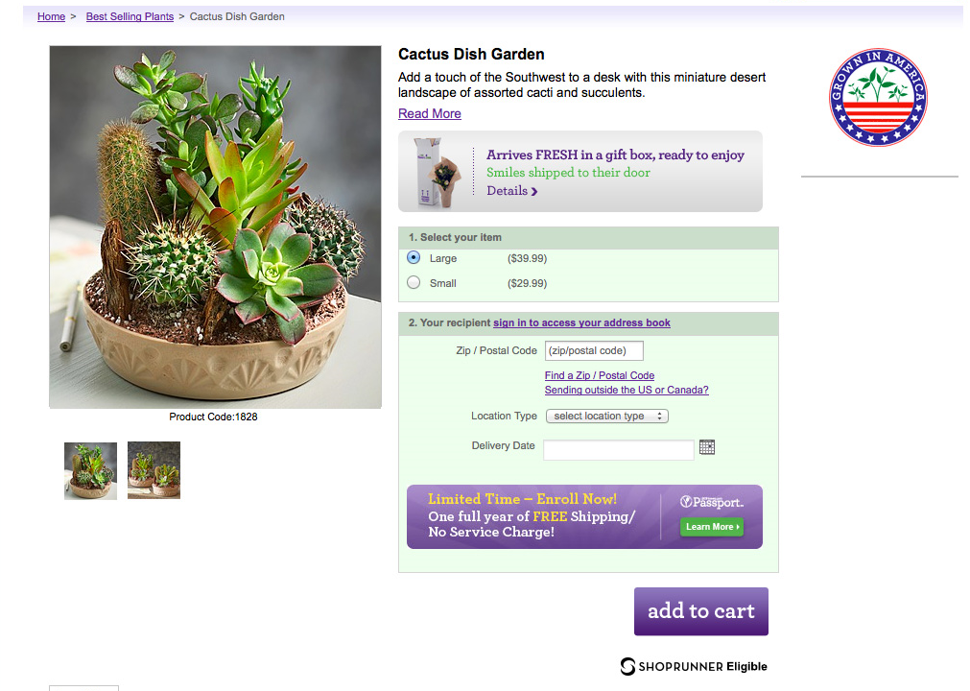
Product Page Placement
sr_productDetailDiv

Slide 8
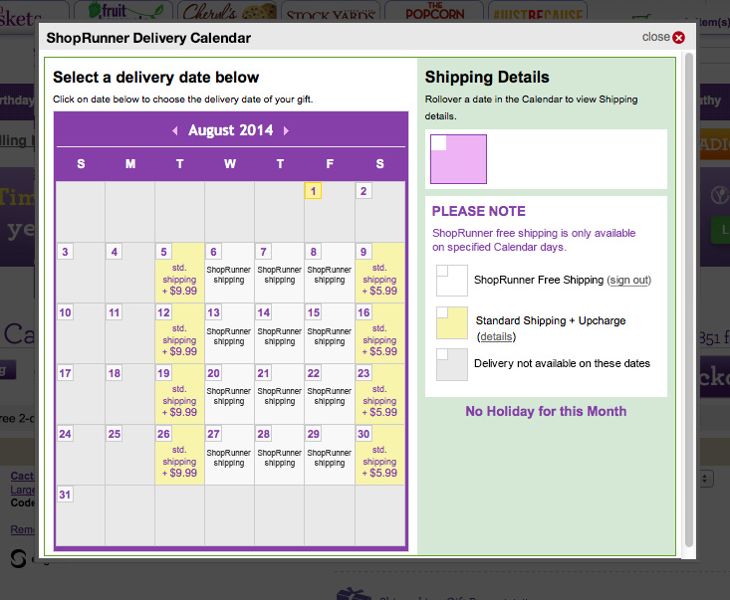
Site Example: Shipping Page
Delivery Calendar
Member
sr_shippingSummaryDiv

Slide 9
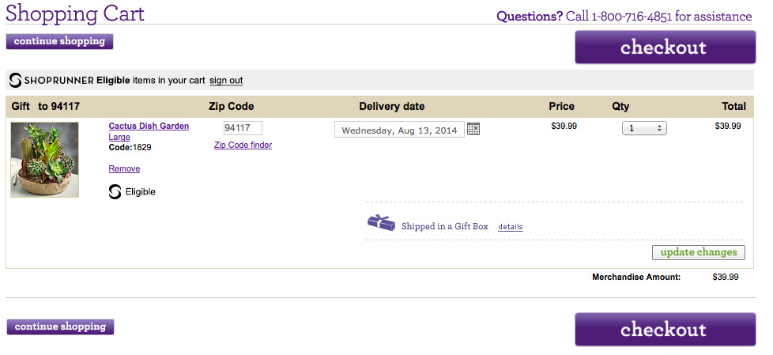
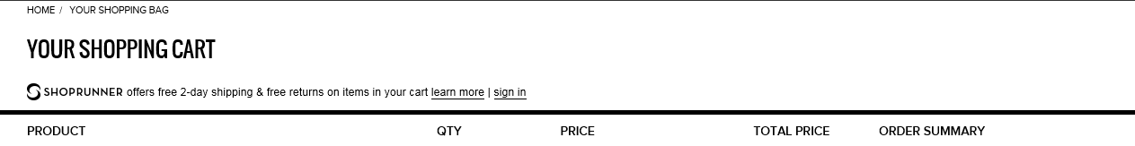
Site Example: Shipping Page
Site Example: Added to Bag/Cart
Member
sr_headerDiv
SR Eligibility Indicator
sr_cartProductDiv
ShopRunner Express Checkout Placements
Non-Member

Slide 10
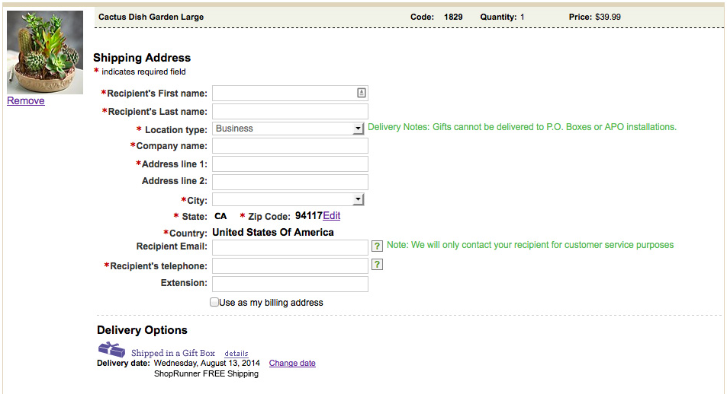
Shipping Address
Member
NOTE: * P.O. Boxes can be supported if the Retail Partner already supports 2-Day shipping to them

Slide 11
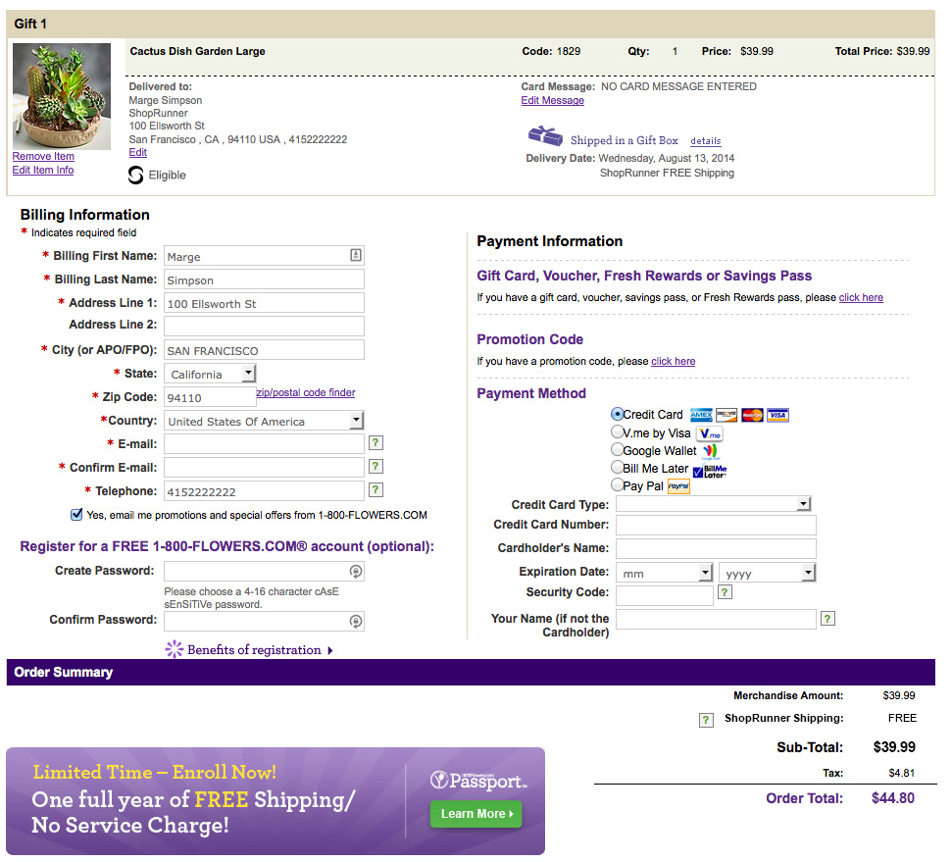
Site Example: Review and Place Order
Member
sr_cartProductDiv

Slide 12
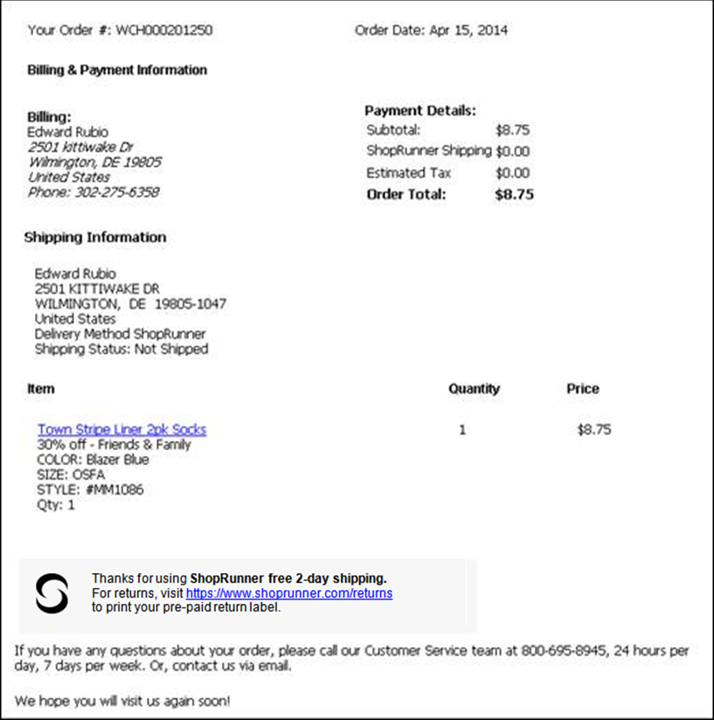
Site Example: Order Confirmation & emails
Customer Communications
Place ShopRunner messaging on order confirmation page, emails
Order Tracking Pixel is leveraged on the Order Confirmation page to provide real-time order information for our members
sr_checkoutSRItemsPageDiv
12

Slide 13
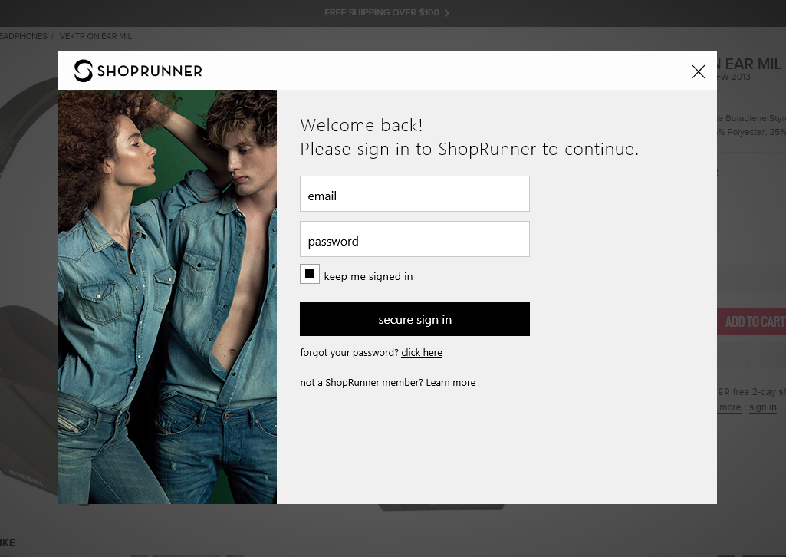

Site Example: ShopRunner Sign-in
Non-Member
13

Slide 14



Member Validation
There are two ways members can sign-in. Either via a persistent sign on token managed by SR or by selecting the sign-in link on a SR Placement
The SR sign-in modal will appear so they can enter their credentials
SR will return a Member Token to you, which you must validate
Validate Token
sr_token
Response
Store sr_token session cookie (created at root, time out TBD < 30 mins)
Set a session variable to indicate ShopRunner Validated Member
14

Slide 15
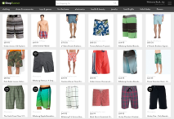
Product Feed
The Product Feed should be sent via SFTP to ShopRunner on a daily basis before 3AM in your time zone
SFTP
The Product Feed allows SR Members to find your products on ShopRunner.com and our Mobile/Tablet apps
Format: JSON is optimal, but XML or CSV is acceptable
If your already create Product Feeds for other needs ShopRunner can evaluate them to see if they fulfill this requirement
15

Slide 16
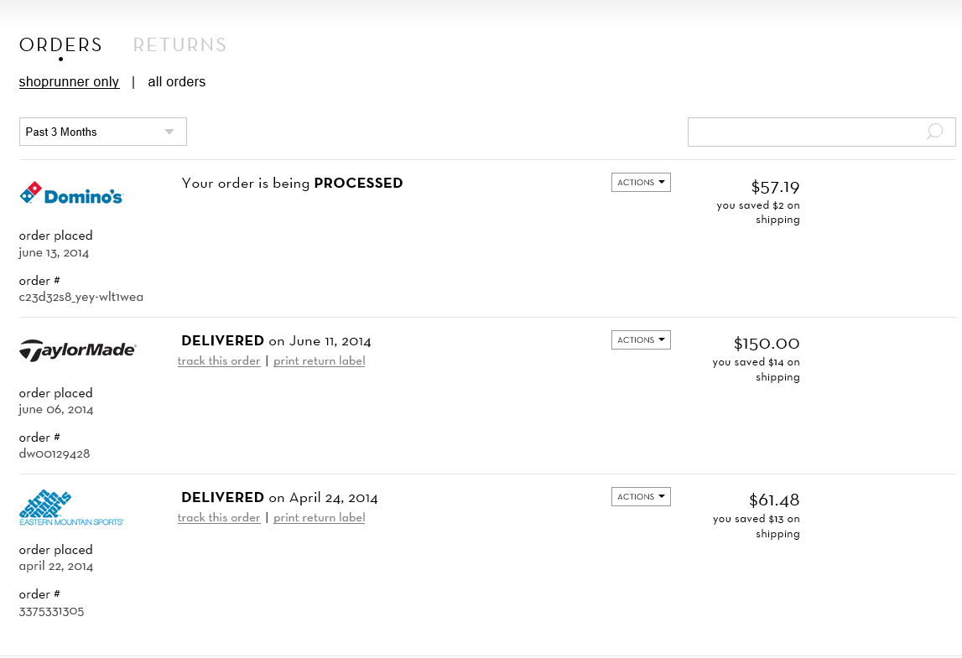
Order Tracking Pixel
The Order Tracking Pixel fires on your Order Confirmation/Success Page and provide basic order information so the member can instantly see their orders on ShopRunner.com
The Order and Shipment feeds also provide information (e.g. Order Status and Tracking Information) for members on ShopRunner.com

Slide 17

Order and Shipment Feeds
The Order and Shipment Feeds should be sent via SFTP to ShopRunner on a daily basis before 3AM in your time zone OR as web service calls in near-real time
SFTP or
Web Services
The Order and Shipment Feeds allows SR Members to see Order Status and Tracking Information on ShopRunner.com
Format: XML File
The Order Feed is use for Financial Reconciliation, Order Cancel and Return information. It is also used to provide SR Performance data in the Partner Portal

Slide 18
Testing and Launch
Testing and Launch discussion should start a minimum of 3 weeks prior to launch date
Partner should complete internal testing before UAT start date
UAT process can take 1-2 weeks depending on the SR Functionality for the project
Certification process is typically an hour or less
Launch should be scheduled for Tues-Thur before 8AM ET if possible. SR will have resources on call for launch support

Slide 19
Next Steps:
ShopRunner & 1800Flowers.com to confirm scope items
ShopRunner & 1800Flowers.com to confirm comp approval
ShopRunner & 1800Flowers.com to confirm setup for staging/production
8 codes, sets of feeds, authentication
SFTP vs. Web Services for Order/Shipment feeds
ShopRunner & 1800Flowers.com to agree on weekly status call schedule & core communication group on 1800Flowers.com side
SR Implementation Manager to deliver
Partner Integration Kit (PIK)
SR Staging credentials
SFTP Staging credentials
developer.shoprunner.com credentials to access SR Online documentation
Test Account
SR IP Address listing

Slide 20
APPENDIX

Slide 21
Member Validation - Flow
Partner
Webpage/listener receives srtoken
Validate srtoken directly with SR via web service call
Update Login State and create srtoken session cookie
Member Browser/PIK
Upon load if Persistent Sign-On token exists it is sent to SR server
Or
Member clicks the sign in link Overlay displays to capture credentials and send to SR server
Send srtoken to Partner's server
Update web page to reflect sign in state
ShopRunner
Validate Credentials or Persistent Sign-On token create srtoken
Return srtoken to PIK
Validate srtoken

Slide 22
Returns
Returns Handling
ShopRunner allows its members to print free return labels from its website. For this we need the address of your returns facility
If you already offer free return shipping then we can provide a link to your site
Returns must still adhere to Retailer’s return policies

Slide 23
Product Feed
Grouping
Fields
Comments
Parent
Parent_SKU, Brand_Manufacturer, Department, Product_Description, Category_Mapping
Send full product specs in Product_Description
General
SKU, Product_Name, ShopRunner_Eligible, Product_URL, Mobile_URL, Regular_Price, Sale_Price, Quantity, Product_Condition, Ship_Weight
Send all information available
Images
Send as many images as possible (multiple angles)
Product Image_URL_Main, Product_Image_URL_Additional
Variations of color, size, etc.
Identifiers
UPC, EAN, MPN, ISBN
Category-Specific
Product Color, Size, Other Attributes (fit, height, etc.), Age Range, Material
These attributes make up the variations
Optional Fields
23

Slide 24
Order Code(Pixel), Order/Shipment Feed
 | Order Code | Order Feed | Shipment Feed
Core Feed Fields | tokenID order ID totalOrderAmount tenderType confirmedProducts -ProductSKU -ProductQty -ProductPrice | Partner SRAuthenticationToken OrderNumber OrderDate AdjustmentDate CurrencyCode OrderTotal BillingSubTotal PaymentTenderType TotalNumberOfItems | Partner RetailerOrderNumber CarrierCode TrackingNumber NumberOfItems
Required if Mixed Cart is supported | -SREligibility (item) NumberOfItems NumberOfSRItems | SRSubTotal TotalNumberOfShopRunnerItems | NumberOfSRItems RetailerReferenceNumber RetailerNotes
Optional Item Level Details |  | SKU Name UnitPrice Quantity SREligible | SKU, Quantity
Optional Fields
24

Slide 25
Order Tracking Code
Grouping
Fields
Comments
Details
orderID, totalOrderAmount, tenderType, NumberOfItems, NumberOfSRItems
Member
tokenID
Items
ProductSKU, ProductQty, ProductPrice, SREligibility,
https://developer.shoprunner.com/dokuwiki/doku.php?id=section_dr2.7
Optional Fields

Slide 26
Order Feed
Grouping
Fields
Comments
General
Partner, SRAuthenticationToken
Order
Details
OrderNumber, OrderDate, AdjustmentDate, TotalNumberOfItems, TotalNumberOfShopRunnerItems
CurrencyCode, OrderTotal, BillingSubTotal, SRSubTotal, PaymentTenderType
Always send the current state of the entire order
SRSubTotal = subtotal of ShopRunner eligible items
Items
(Optional)
SKU, Name, Quantity, UnitPrice, SREligible
https://developer.shoprunner.com/dokuwiki/doku.php?id=section_dr2.8.2-1
Optional Fields

Slide 27
Shipment Feed
Grouping
Fields
Comments
General
Partner
Order/Package
RetailerOrderNumber, NumberOfItems, NumberOfSRItems
Tracking
CarrierCode, TrackingNumber
Items
(Optional)
Quantity
Custom Fields
(Optional)
RetailerReferenceNumber, RetailerNotes
https://developer.shoprunner.com/dokuwiki/doku.php?id=section_dr2.8.3-1
Optional Fields

